Slide 1
Characterizing US Counties With High and Low Population Density
Oliver Einarsson, Gina Fender, Morgen Henry, Ryan Krause, & Mark Speers
Notes:
Everyone - Hello! Our names are Oliver Einarsson, Gina Fender, Morgen Henry, Ryan Krause, and Mark Speers. Today, we will be discussing our Characterization of counties with high and low population densities in the United States.

Slide 2
Economic Factors Considered
Cost of Living
Household Income
Income per Capita
Education Rates
Notes:
Morgen
For this analysis, we considered the following economic factors:
Cost of living, or the amount of money required to cover necessary expenses to maintain a certain lifestyle standard in a particular place and time. For this project, we will be representing this factor through one variable: the median rent of a county.
Income per Capita, or the total income of a county divided by every single person that resides within that county, even including newborns.
Household income is the income of all members of a common address, above a specified age, on average within a county.
For this project, we are defining Education Levels as the percentage of people who achieve different degrees of higher education (ie. Bachelor's, Master's, etc.).

Slide 3
PRIMARY GOAL
Determine if it is a better financial decision to live in a densely or sparsely populated county when choosing a place to live in the United States.
Notes:
Morgen - Imagine you are looking to move to a new county and ask yourself "can I afford to live somewhere densely populated?". This investigation should inform you what you can expect when moving to a densely or sparsely populated county.

Slide 4
Benefit of investigating this Relationship
Are most counties in the US densely or sparsely populated?
Are most counties in the US similar in size?
Does it cost more to live in a densely populated county?
Do workers in densely populated counties have a higher income?
What highest level of education is most common in dense versus sparse counties?
Do you need to have a high level of education to have a high income in US counties?
Notes:
Morgen - By understanding the relationship between population density and these factors, we can gain better insight into questions such as the following: (questions on slide)

Slide 5
Data Collection & Clean up
Data Sources
Data Clean Up
US County Level Census:
https://www.ers.usda.gov/data-products/county-level-data-sets/
Issue Experienced: When using this site, it is MUCH easier to use if the census wrapper is used as well.
U.S Department of Agriculture Website
https://www.ers.usda.gov/data-products/county-level-data-sets/
Data was retrieved from these APIs and merged to create a single census data frame.
Issue Experienced: When attempting to merge this data, our resulting data frame had many "NaN" values added in. We found that this was due to different lengths of the datasets and adjusted our merge method to correct for this.
Notes:
Mark/Gina
# Data Collection and Cleanup - Part of the data was sourced from the American Community Survey using the Census wrapper. This data included: total population, state, median gross rent, income per capita. Data was at the county level for the year 2020. The second portion of the data, including the size of each county, was sourced by Gina. - ...(Gina, are you cool with coming in here to describe your data?) ## Data Cleaning Steps - Histograms were constructed to explore the data and some missing values were identified and removed. - Some other cleaning steps were: splitting one column into two, reformatting state abbreviations, and removing particular rows. - Issue experienced: ...(are you also cool coming in here to describe the merging issue?)... - After missing data was removed, the final merge was performed. The resulting dataset included: - county name - state - size of county in $mi^2$ - median gross rent - income per capita - education rates (edited)
[2:22 PM]
I have two portions marked in parentheses where I felt you could take over

Slide 6
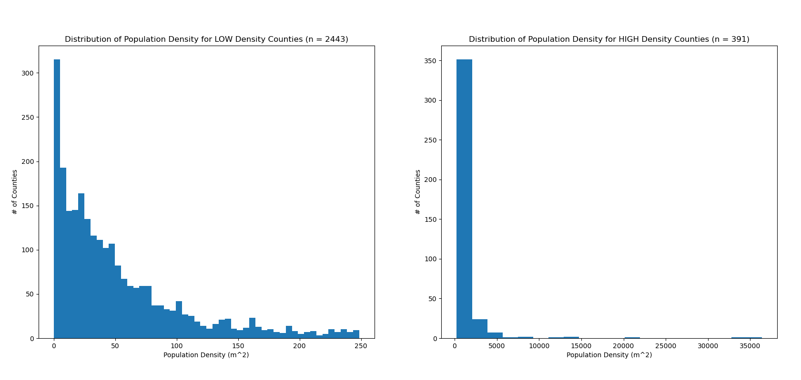
Population Density
Figure 1: Histograms of Population Density
Notes:
Mark
Here we show the number of counties with high and low population density.
You may notice that this graph is split into two groups. This is because the majority of counties have a relatively low population density, resulting in very negatively skewed data. We decided to separate this data into two groups, counties with a density of less than 250 people per square mile and counties with a density greater than 250 people per square mile.

Slide 7
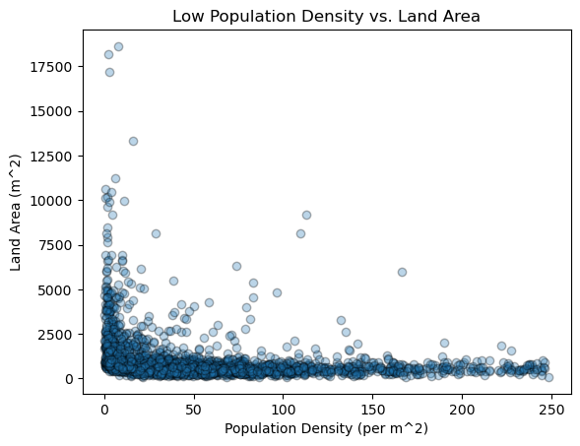
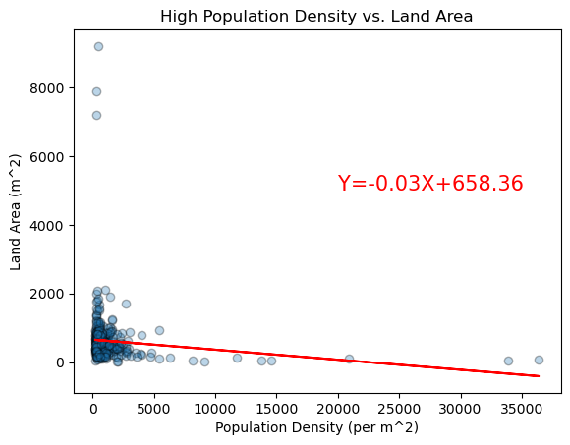
Land Area
Figure 2: Scatter plots of Population Density vs. Land Area (by square mile)
Notes:
Morgen
For counties with low population densities, we do not see a relationship between population density and land area. However, for densely populated counties, as population density increases, the land area decreases, a negative correlation. These counties most likely contain cities where there are many residents in a small amount of space.

Slide 8
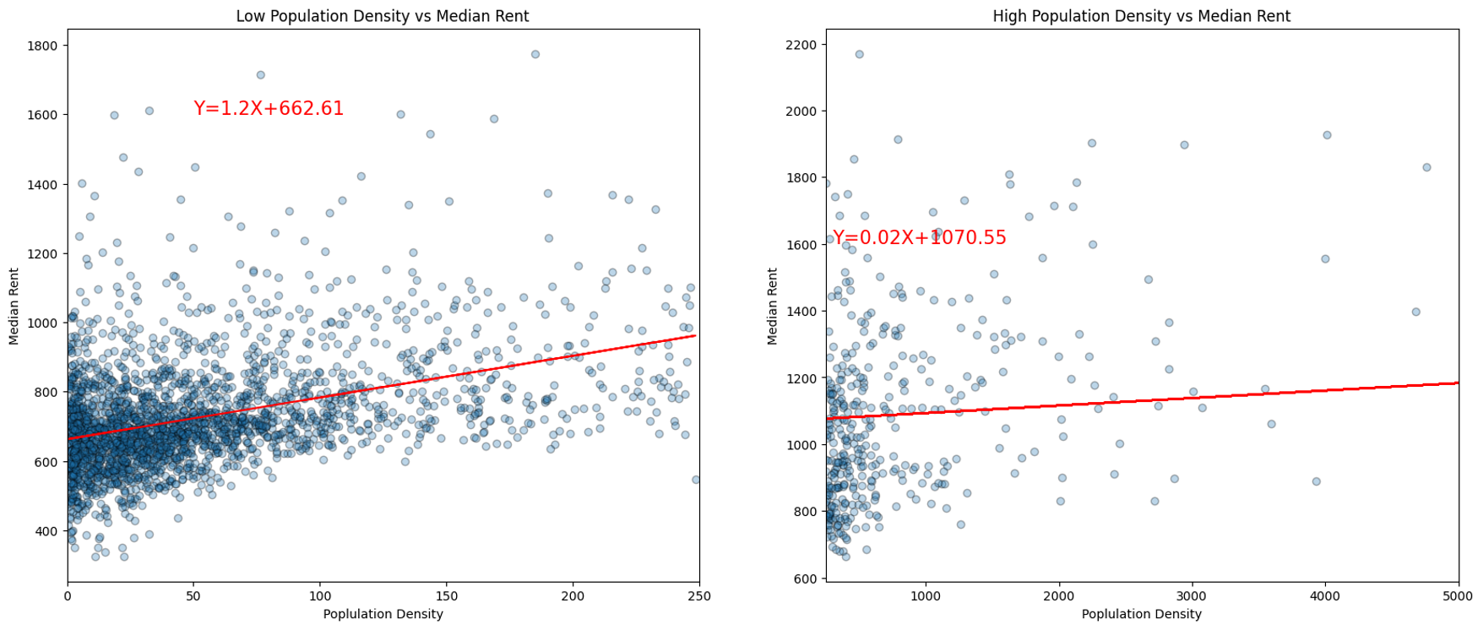
Cost of Rent
Figure 3: Scatter plots of Population Density vs. Median Rent
Notes:
Ryan
We looked at one factor in the cost of living, median rent. We found that the cost to live in a county increases as population density increases.

Slide 9
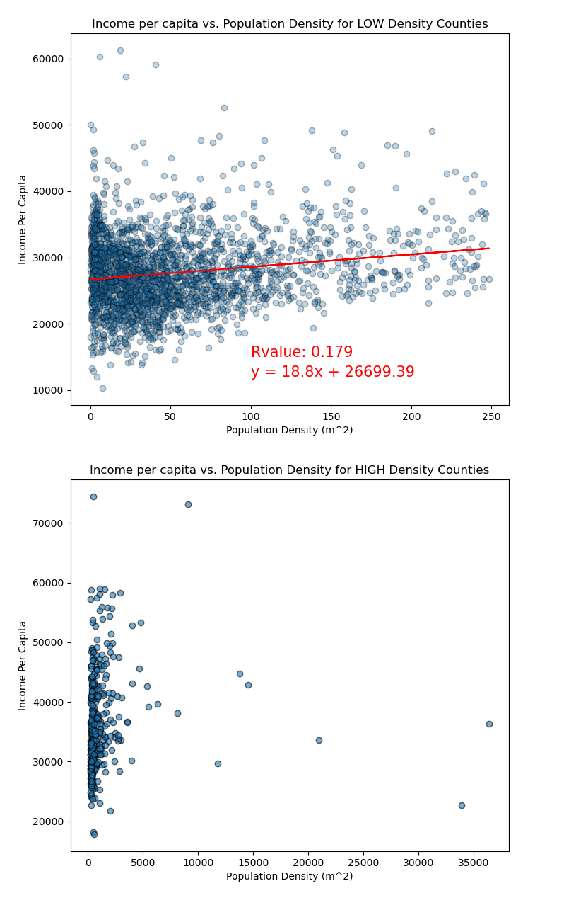
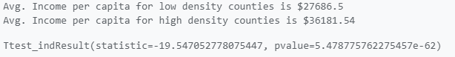
Income per Capita
Subsequent T-test
Figure 4: Scatter plots of Population Density vs. Income per Capita
Notes:
Mark
One visualization was produced and three analyses were conducted to reveal the nature of the relationship between income per capita and population density.
First, scatter plots were made and Pearson's r was calculated. This revealed the nuances of the relationship between income per capita and population density of counties. If the relationship was significant, a linear regression was performed.
For low density counties, Population density's relationship with income per capita was statistically significant: p = 5e-19, but the relationship is very weak: r=0.179. This relationship was plotted using a linear regression.
Unfortunately, it is very likely that we violated the assumptions of this regression.
In particular, the linearity of the relationship is questionable.
Additionally, because of how many data points we have, this test may be a bit overpowered.
Comparatively, for high density counties, Population density's relationship with income per capita was not statistically significant: p = 0.14
Because the relationship was so weak, a welch's t-test was conducted to provide an answer to our question "Do workers in densely populated counties have a higher income?". This test revealed that income per capita is significantly higher in high density counties (counties with more than 250 people per square mile). Income per capita for high density counties is about 9,000 dollars higher than in low density counties.

Slide 10
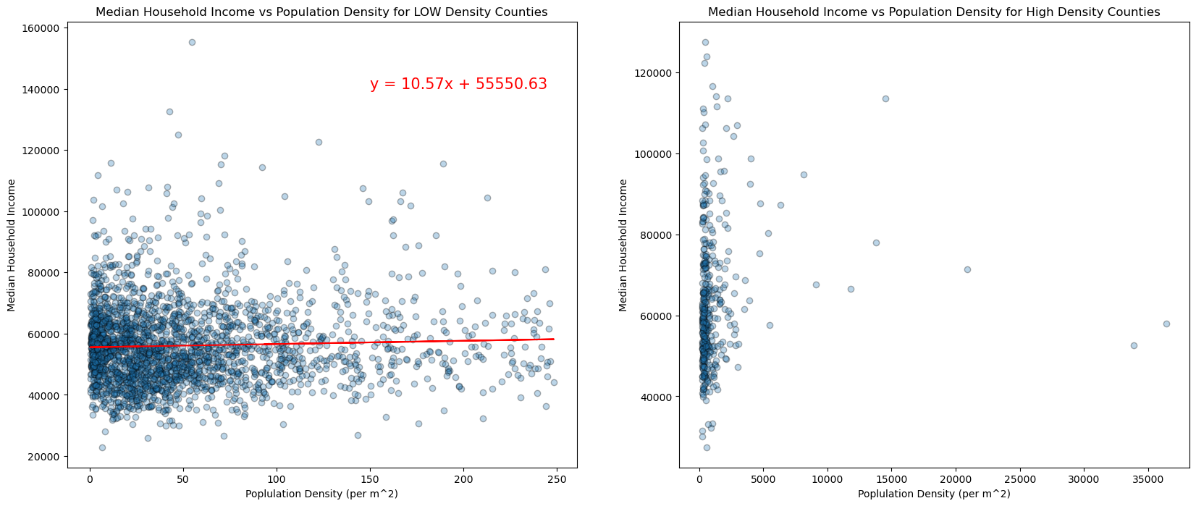
Median Household Income
Figure 5: Scatter plots of Population Density vs. Median Household Income
Notes:
Oliver
For counties with low population density, we found a moderate positive correlation between population density and median household income. We did not see this correlation in densely populated counties.
This is similar to what we found with income per capita, which considers all residents (even newborns) and their average income. Here we can see that the correlation in sparsely populated counties strengthens when considering income by household instead of individual residents.
Since the cost of rent increases with population density, we would hope to see this counteracted with a parallel increase in income. We do not see this in highly populated counties, which could potentially make it harder to afford to live in these areas.

Slide 11
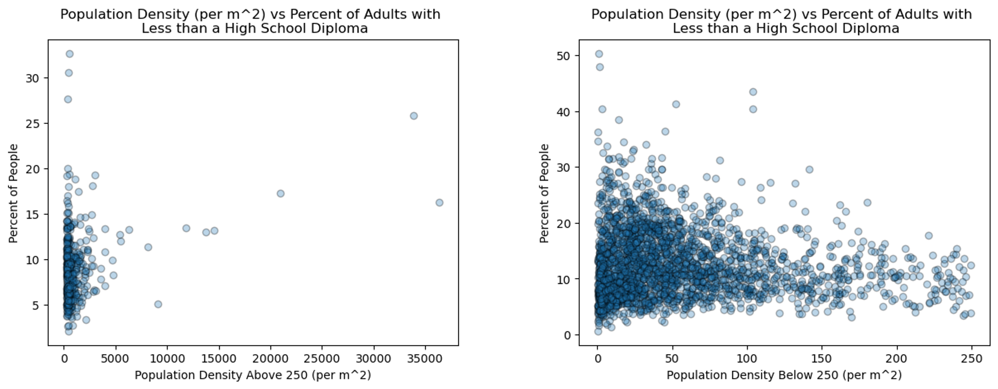
Education – Less than High School Degree
Figure 6: Scatter plots of Population Density vs. Percent of People with Less than a High School Degree
Notes:
Gina
In counties with low population density, we see a slight negative correlation between population density and percent of people with less than a high school degree.
In counties with high population density, we see a weak positive correlation between population density and percent of people with less than a high school degree.

Slide 12
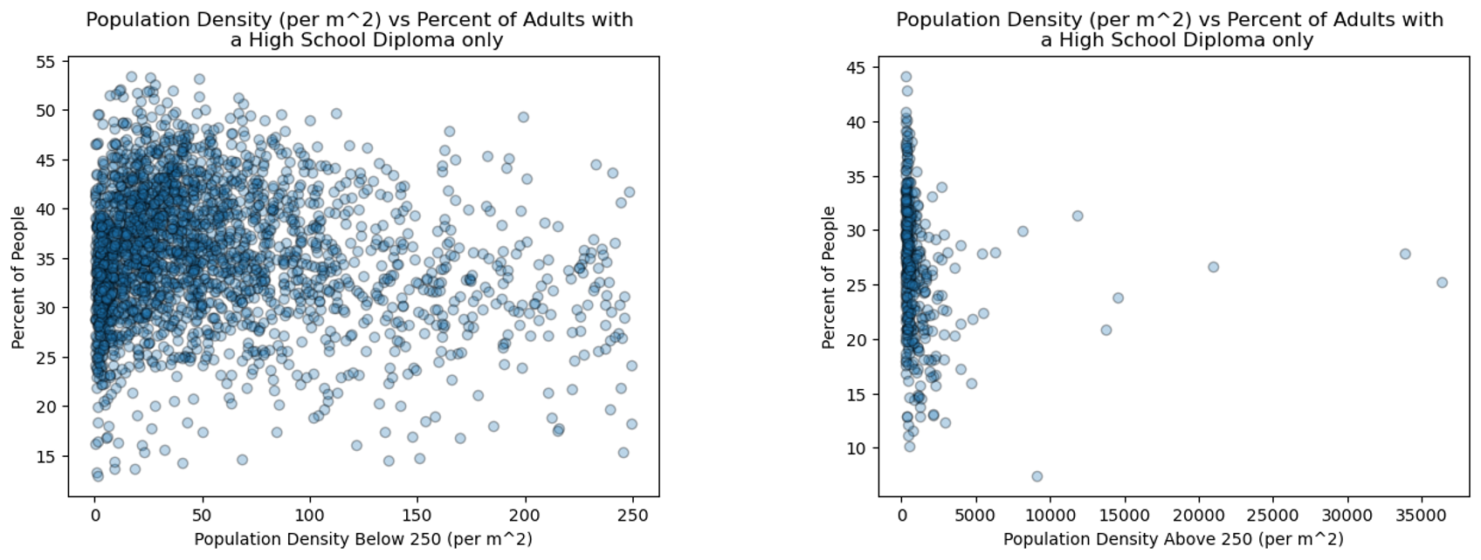
Education – High School Degree
Figure 7: Scatter plots of Population Density vs. Percent of People with Only a High School Degree
Notes:
Gina
In counties with low population density, we see a weak negative correlation between population density and percent of people with only a high school degree.
In counties with high population density, we see a weak negative correlation between population density and percent of people with only a high school degree.

Slide 13
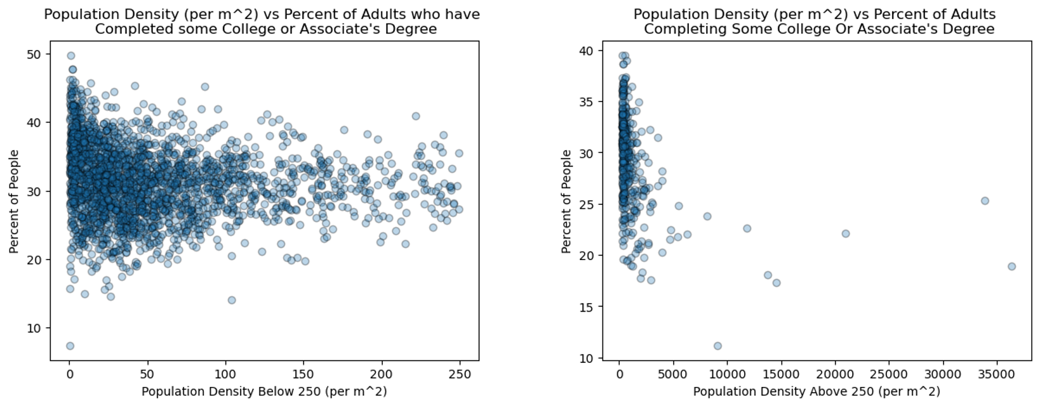
Education – Some College/Associate's Degree
Figure 8: Scatter plots of Population Density vs. Number of People with Some College/Associate's Degree
Notes:
Gina
In counties with low population density, we see a weak negative correlation between population density and percent of people with some college or an associate's degree.
In counties with high population density, we see a somewhat weak negative correlation between population density and percent of people with some college or an associate's degree.

Slide 14
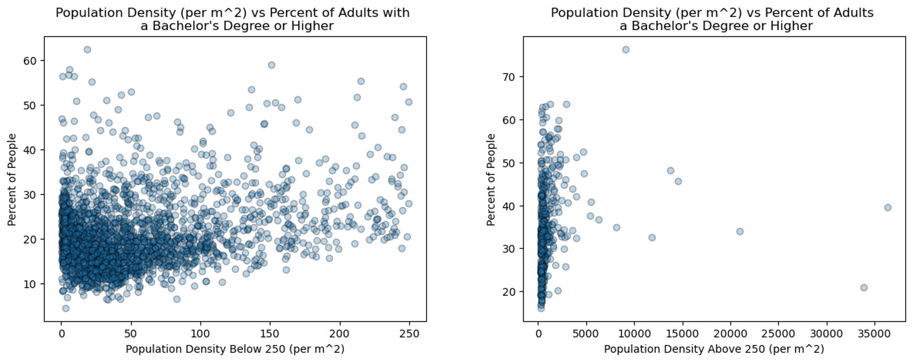
Education – Bachelor's Degree or Higher
Figure 9: Scatter plots of Population Density vs. Percent of People with a Bachelor's Degree or Higher
Notes:
Gina
In counties with low population density, we see a weak positive correlation between population density and percent of people with a Bachelor's or higher degree.
In counties with high population density, we see a weak positive correlation between population density and percent of people with a Bachelor's or higher degree.

Slide 15
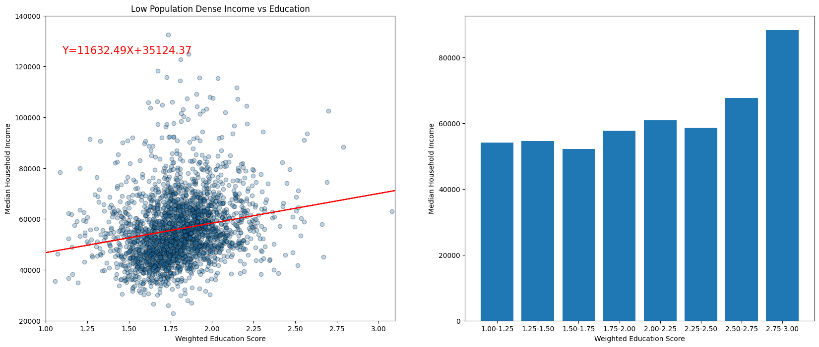
Education Vs. Income in Sparsely Populated Counties
Figure 6: Scatter plots of Number of People with Higher Education vs. Median Household Income
Notes:
Ryan
In sparsely populated counties, we found a weak positive correlation between education level and median household income. This may mean that having a higher level of education results in a greater income or that a greater income provides more opportunities to achieve higher education.

Slide 16
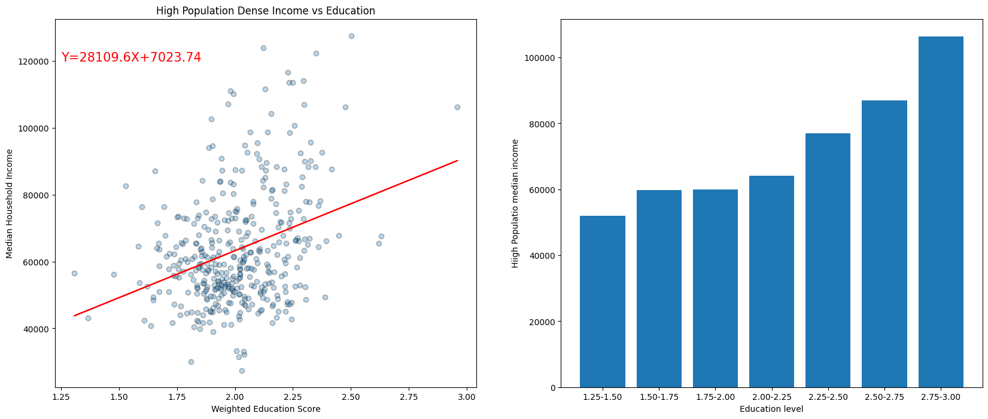
Education Vs. Income in Densely Populated Counties
Figure 6: Scatter plots of Number of People with Higher Education vs. Median Household Income
Notes:
Ryan
In densely populated counties, we found a positive correlation between education level and median household income. This may mean that having a higher level of education results in a greater income or that a greater income provides more opportunities to achieve higher education.

Slide 17
Significant Relationships
Cost of Rent
Sparsely Populated Counties - Income
Education and Income
As population density increases, so does the cost of living. This could be due to increased competition for housing.
For both income per capita and median household income, we see that as population density increases, so does the income of residents.
While we did not find a correlation between highest level of education and population density, we do see that as income increase so does highest level of education.
Notes:
Oliver
*all text on slide*

Slide 18
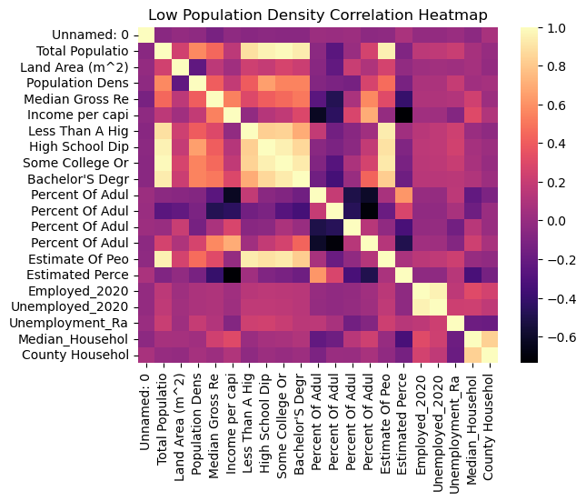
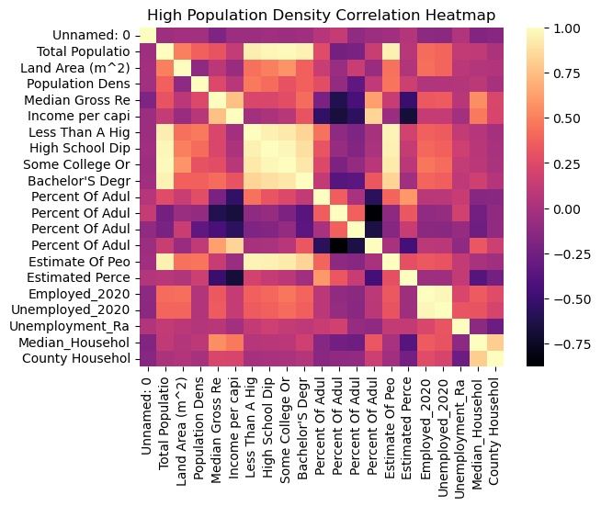
Analysis Summary
We found significant correlations between population density and these three factors, but could we have done so more easily?
We created a heat map depicting the correlations between all factors from the Census. Not only can we easily see factors that have a correlation with Population Density by look at the fourth row/column, but we can also see how these factors relate to each other. In the future, we will consider this method to save a significant amount of time!
Notes:
Oliver
*all text on slide*

Slide 19
THANK YOU for Your Attention!
Notes:
Everyone

